Slide 1
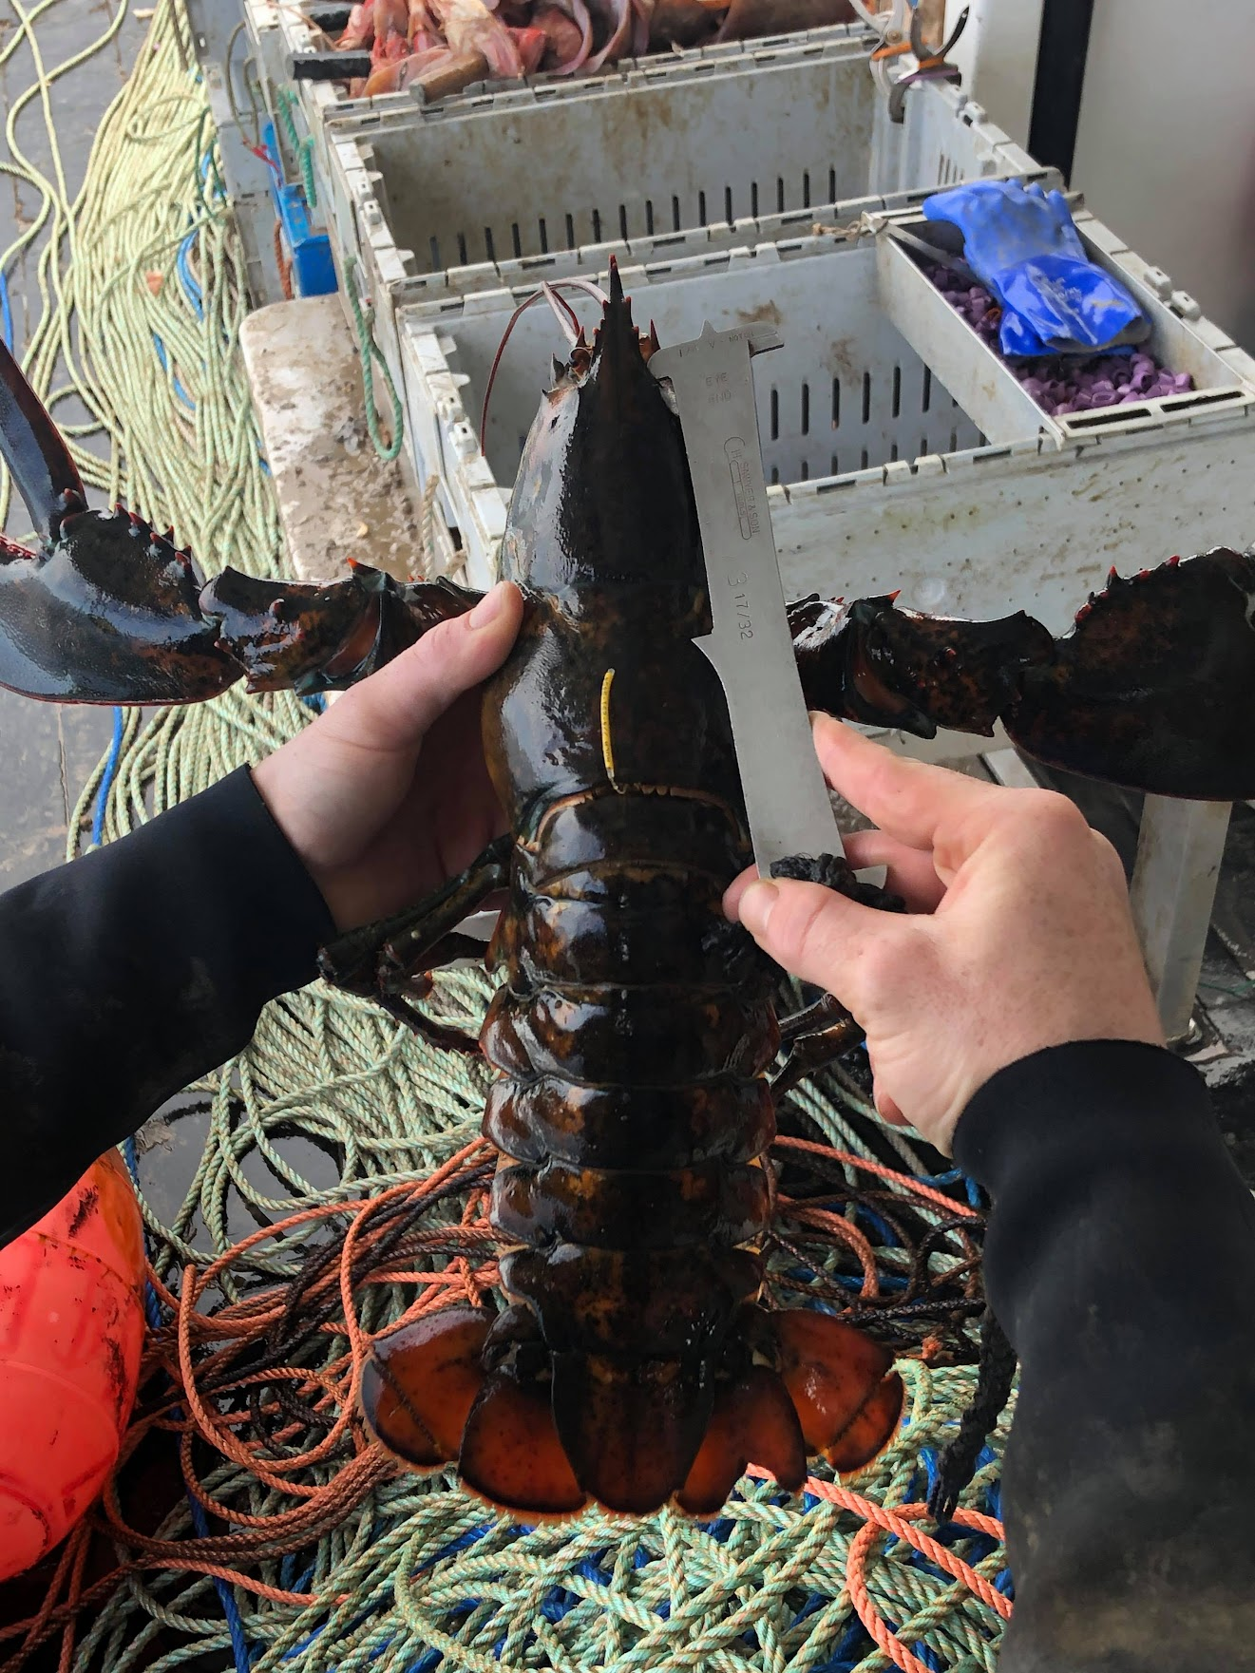




Tracking Exchange Between Offshore GOM Regions via Tagging
National Sea Grant Regional Research and Outreach Summit: Modeling, Monitoring and Forecasting
Everett Rzeszowski¹, Damian C. Brady¹, Kathleen Reardon², Joshua Carloni³, Heidi Henninger⁴
1. University of Maine Darling Marine Center,
2. ME Dept. of Marine Resources,
3. NH Fish & Game,
4. Atlantic Offshore Lobstermen’s Association

Slide 2
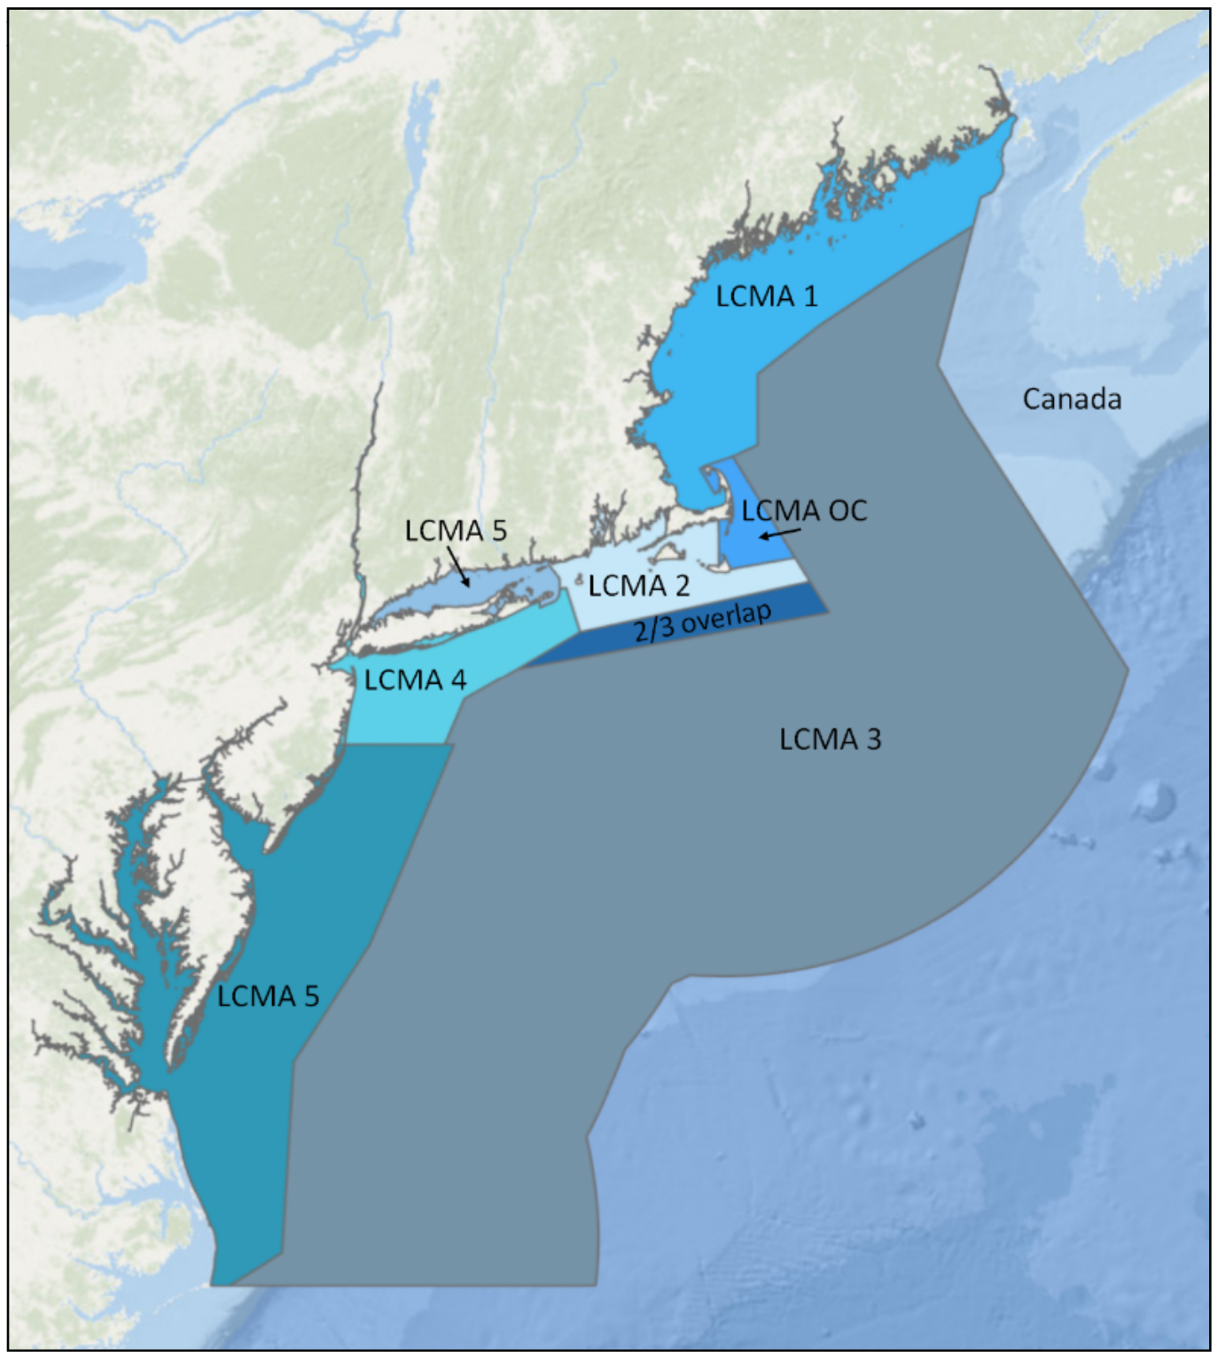
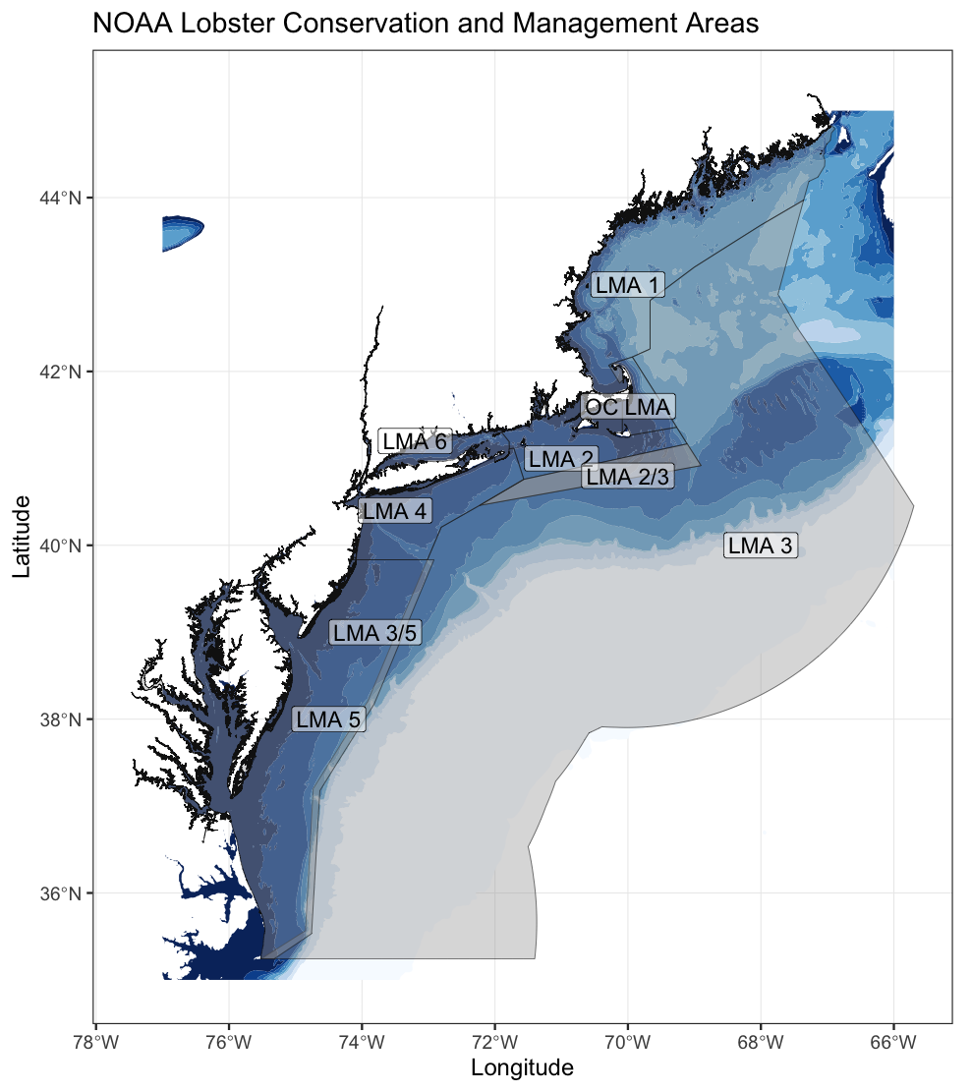
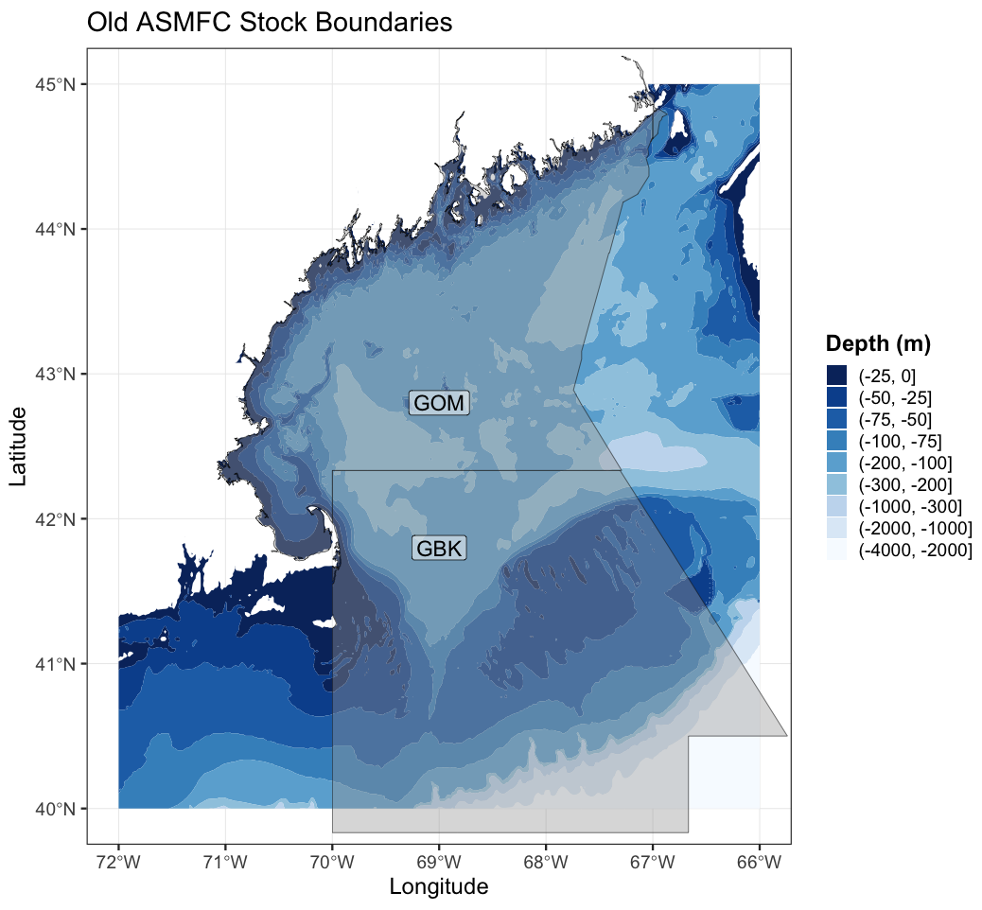
Project Design and Goals
Address 2015 ASMFC Stock Assessment research priorities.
“Examine stock connectivity between GOM and GBK”
“Update information on growth and maturity”
6
Map of Old ASMFC stock boundary between GOM and GBK.
Map of NOAA Lobster Conservation Management Areas.
Notes:
State project goals: from the project report

Slide 3
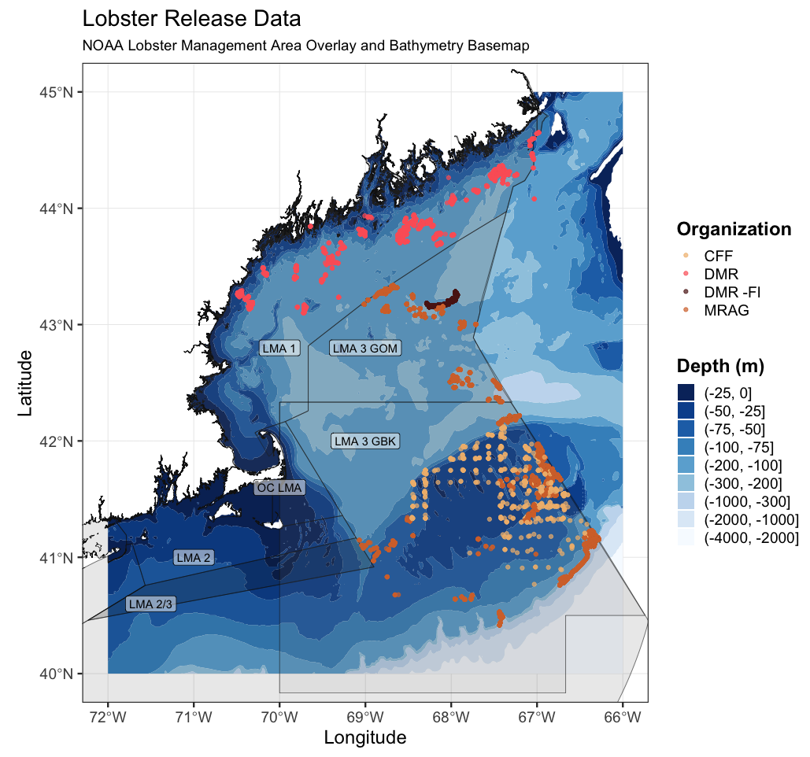
Tagging Effort
2015 - 2016 (Pilot Study), 2017 - 2020 (Full Tagging Study)
Tagging completed by 4 organizations.
MRAG Americas (Fishery Dependent)
ME DMR (Fishery Dependent)
ME DMR (Fishery Independent)
CFF (Fishery Independent, Dredge Sampling)
Map of release locations colored by tagging organization, study area geometry overlain.

Slide 4
Current Project Topics
Seasonal cycles of depth migration.
Differing depth preference according to egg maturity.
Cohort-specific growth rates of lobster at large.
Seasonal biases in recapture location.
Exchange rates of lobsters between study areas.

Slide 5
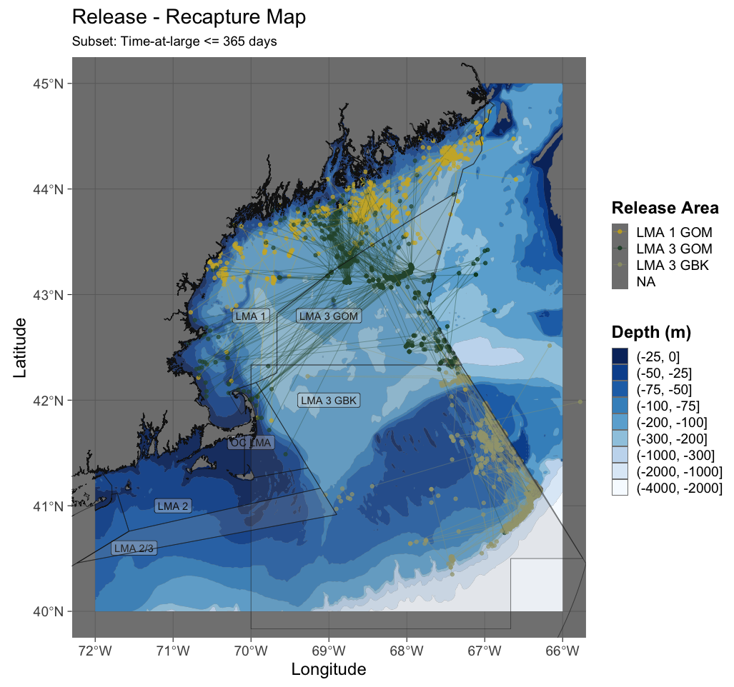
Mapping Tag Exchange
LMA 1 and LMA 3 GBK travel a shorter distance to recapture than LMA 3 GOM.
LMA 3 GOM lobsters have variable directional patterns.
Map of lobster release and subsequent recaptures colored by original study area. Time at large ≤ 1 year.

Slide 6
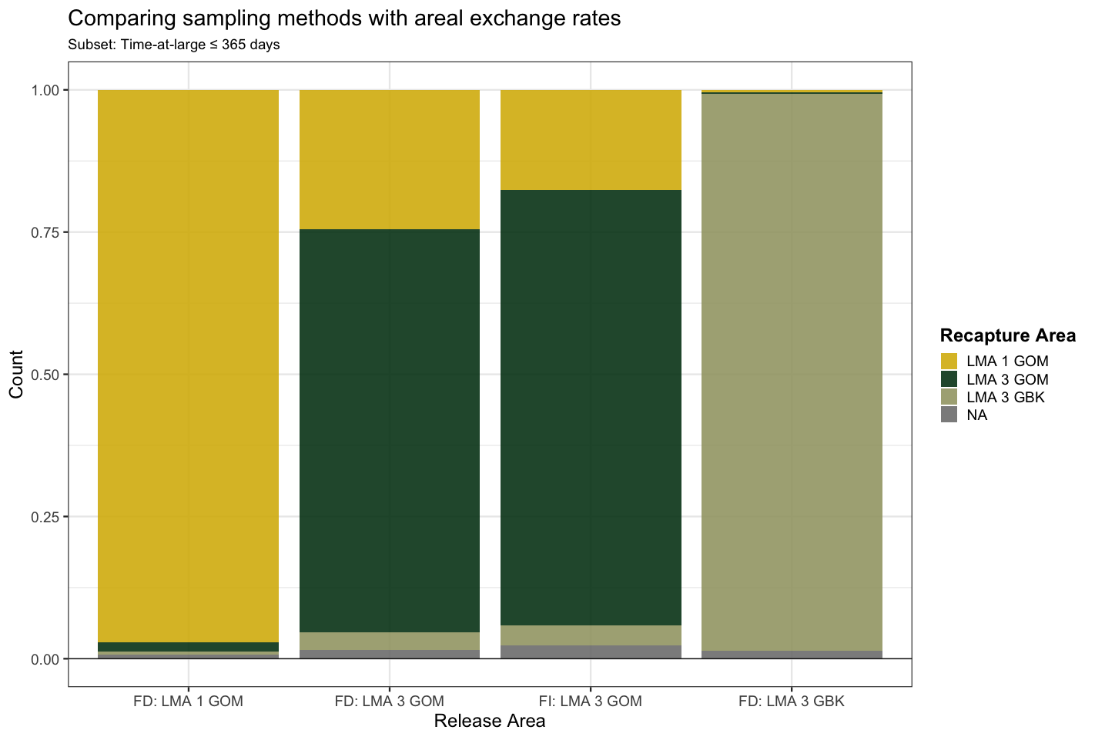
Quantifying Tag Exchange
Of lobsters recaptured ≤ 1 year at large:
LMA 1 and LMA 3 GBK exhibit regional fidelity.
LMA 3 GOM (fishery-dependent and independent) tagged lobsters show a higher level of exchange.
Proportional bar chart comparing study area exchange between the three study areas and two protocol types.

Slide 7
Takeaway Points
On an annual scale there is a low rate of direct exchange between LMA 1 and LMA 3 GBK lobsters.
The LMA 3 GOM acts as a transitional region, interacting with both LMA 1 and LMA 3 GBK lobsters via exchange.
Fishery-dependent and independent protocols observe similar exchange rates.

Slide 8
Thank you for listening!
Acknowledgements:
This project was funded by NOAA but was made possible by fishermen who allowed research technicians to tag lobsters aboard their vessels, some over multi-day trips, and have continued to report recapture data to AOLA from the project’s inception through the present.

Slide 9
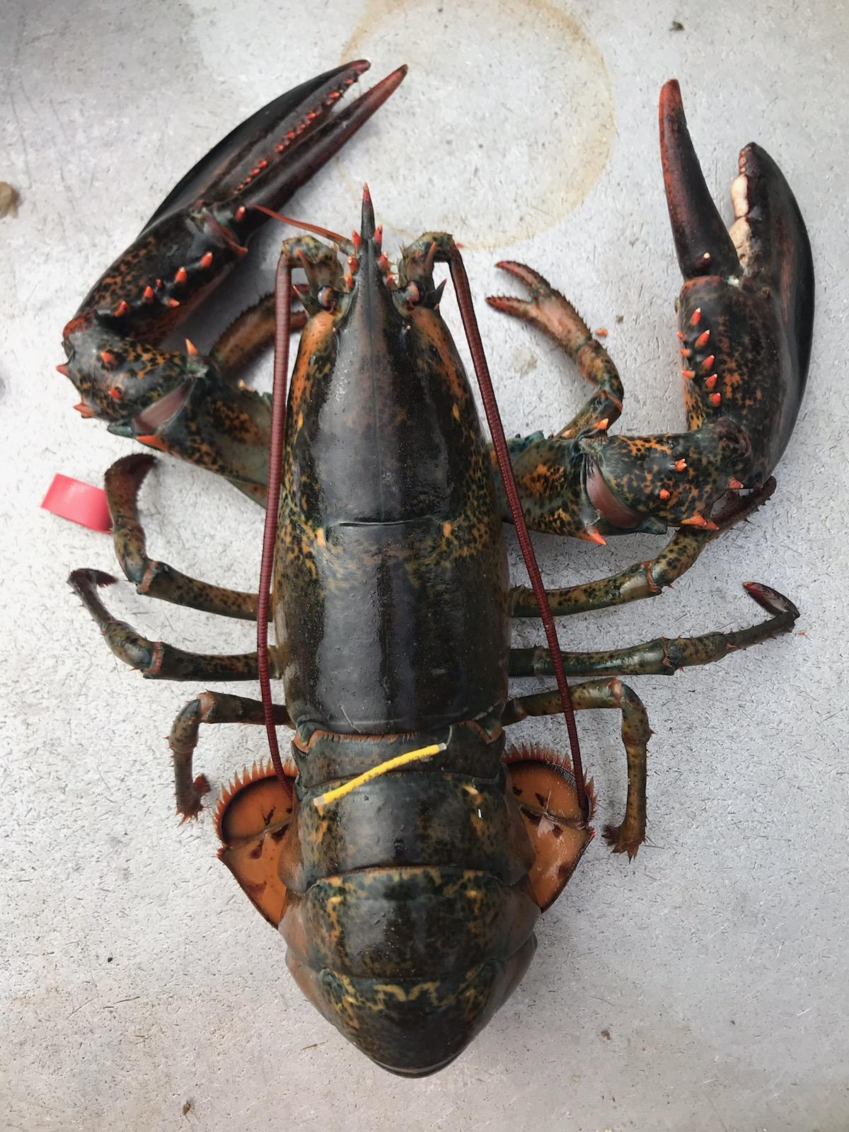
Questions?

Slide 10
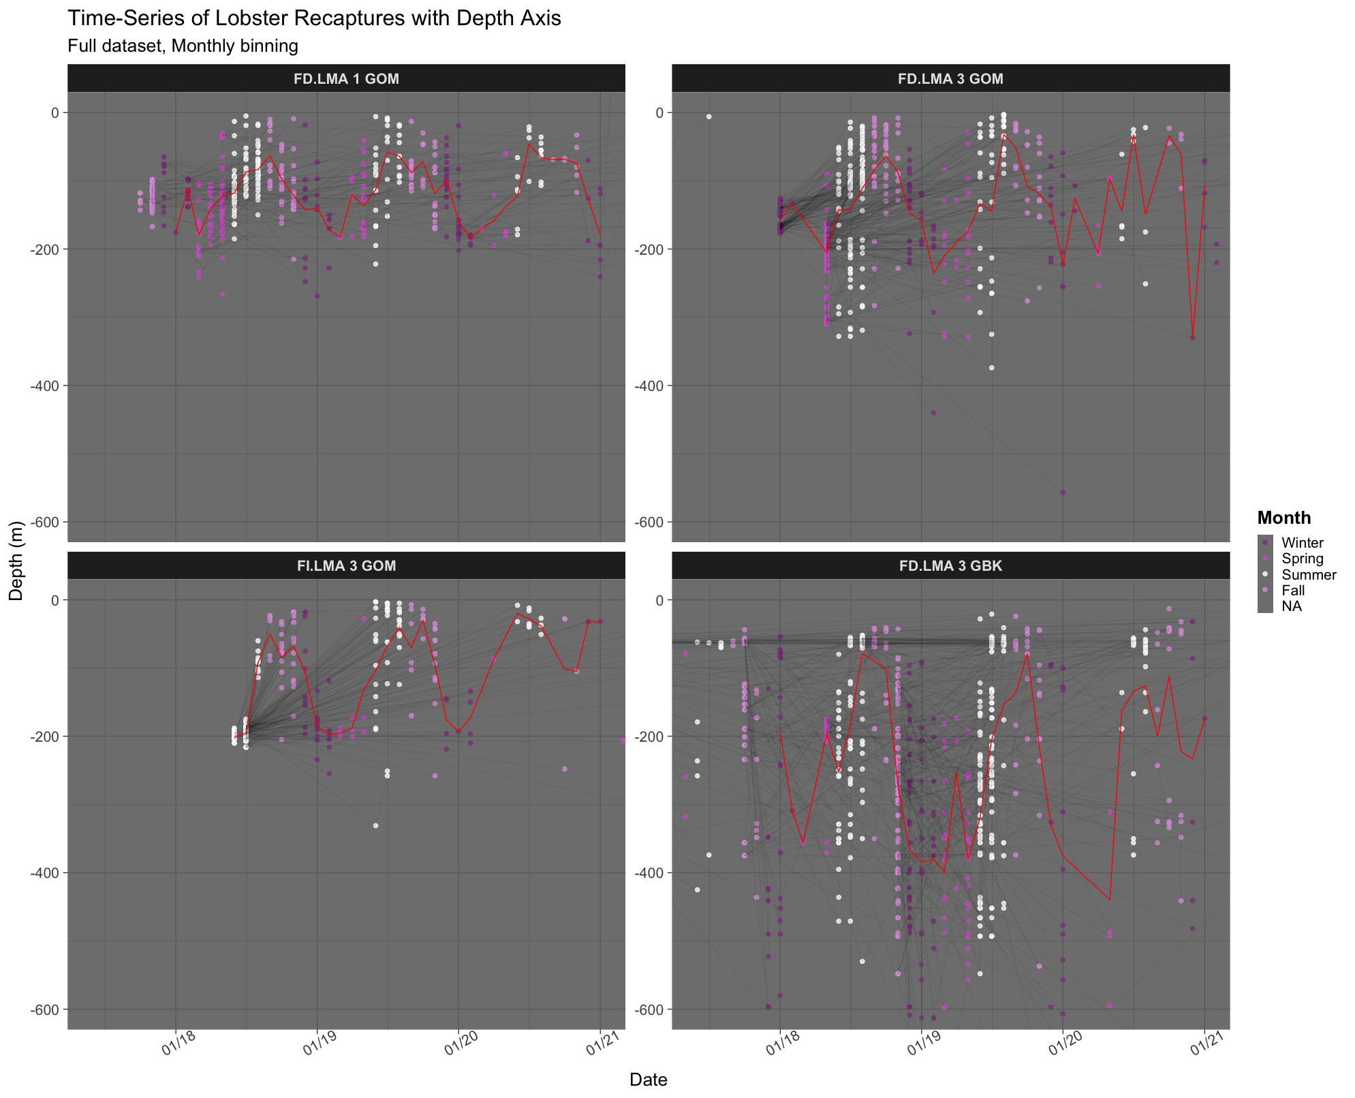
Time Series
For each study area and protocol an annual cycle in depth is present with peaks in summer and trough in winter.
Time series of depth for release - recapture.

Slide 11
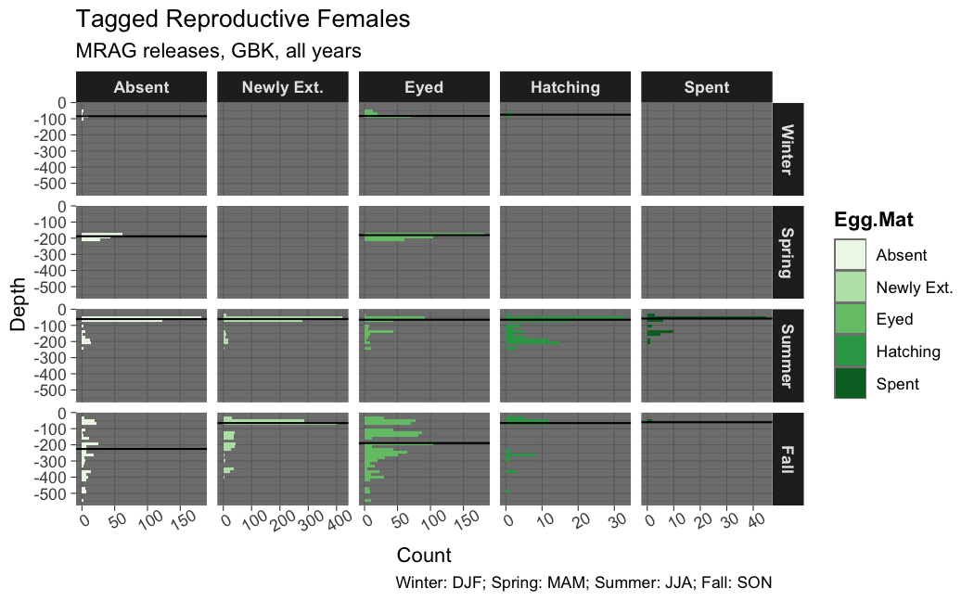
Egg Stage and Depth
Depth preferences between groups are similar except in Fall.
Histogram indicating seasonal depth preference of each group of reproductive females. Median lines are plotted for each maturity x season group. Data is from MRAG releases on GBK.

Slide 12
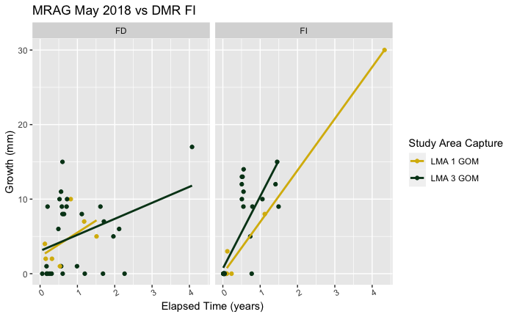
Fishery-dependent and independent growth rates
Fishery-dependent (discards) show slower growth than independent (all lobsters).
This may be due to differences in energy expenditure between reproductive females and other lobsters.
Scatterplot of absolute growth and time-at-large. Linear regressions are fit to estimate growth rate for each group.

